Slide 1


Pets’ Love
项目报告
成员：韩驭洲 张泰银 杨洋

Slide 2

01
张泰银 杨洋
后端逻辑部分
Notes:
减去对角的矩形内可填充小标或章节提案人名

Slide 3
01
后端完成的逻辑部分（宠物）
1
01
完成了宠物的增加删除修改。
2
02
完成了宠物的恋爱历史。
3
03
完成多个宠物对应一个主人功能。
4
04
OPTION
完成了宠物细节展示

Slide 4
01
后端完成的逻辑部分（用户）
1
01
完成了用户的登录注册。
2
02
完成了用户的信息修改
3
03
完成了用户查询自己所属宠物功能。
4
04
OPTION
完成了用户的关注，粉丝功能。

Slide 5


后端未完成的部分
01
即时通讯功能
02
给宠物加V功能
03
定位并提供距离功能
04
将本地图片转换成url功能
Notes:
点击文字部分进行编辑，CONTENT彩色效果为填充图片

Slide 6

02
韩驭洲
前端部分

Slide 7


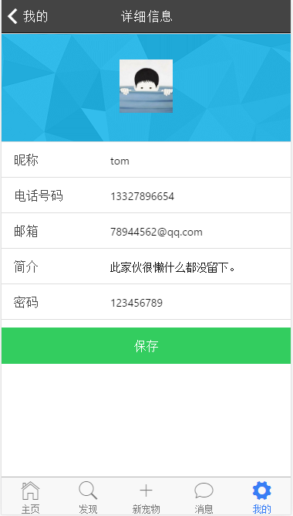
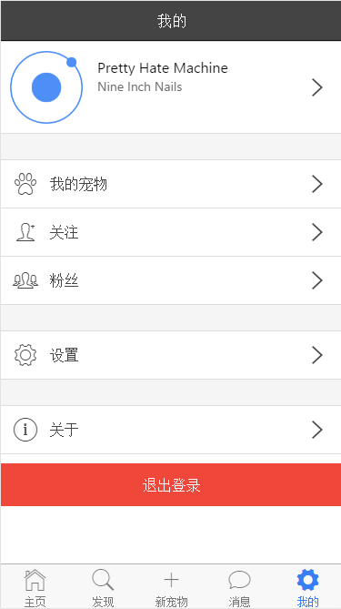
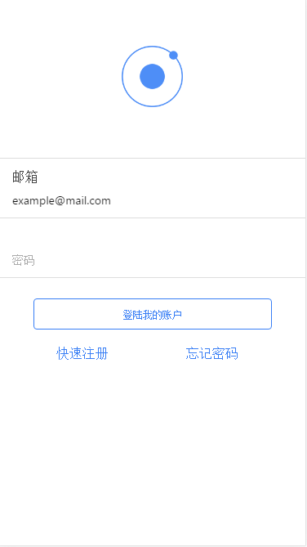

02
前端完成的界面部分
注册
登陆
找回密码
账户界面
关于
设置

Slide 8

02
前端未完成的部分
主页
附近
发布宠物
逻辑部分
宠物详情
。。。

Slide 9







T
H
A
N
K
S
！

Slide 10
01
Click to add your text
OPTION 2
OPTION 4
Click to add your word click to add your word
Click to add your word click to add your word
2011
2012
2013
2014
2015
2016
2017
2018
Click to add your word click to add your word
Click to add your word click to add your word
Click to add your word click to add your word
OPTION 1
OPTION 3
OPTION 5
Notes:
时间轴上的彩色条可以添加或更改，表示时间段

Slide 11
01
Click to add your text
2013
2014
2015
2016
2017
OPTION 1
OPTION 2
OPTION 3
OPTION 4
OPTION 5
Click to add your word click to add your word
Click to add your word click to add your word
Click to add your word click to add your word
Click to add your word click to add your word
Click to add your word click to add your word
01 product
02 product
03 product

Slide 12




01
Click to add your text
S
W
O
T
Strengths
Weaknesses
Opportunities
Threats
Click to add your word click to add your word
click to add your word
click to add your word
Click to add your word click to add your word
click to add your word
click to add your word
Click to add your word click to add your word
click to add your word
click to add your word
Click to add your word click to add your word
click to add your word
click to add your word
Notes:
S W O T可修改

Slide 13

02
XX XX
Click to add
your text

Slide 14

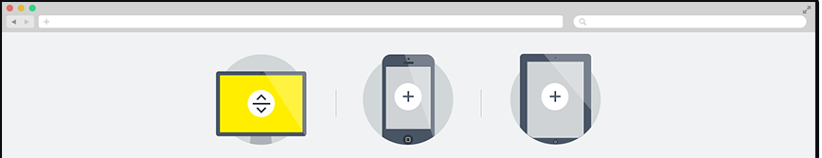

02
Click to add your text
01
Click to add your word click to add your word click to add your word click to add your word click to add
02
Click to add your word click to add your word click to add your word click to add your word click to add
Click to add your word click to add your word click to add your word click to add your word click to add
Click to add your word click to add your word click to add your word click to add your word click to add
03
TEXT
TEXT
Click to add your word click to add your word click to add your word click to add your word click to add
04

Slide 15


02
Click to add your text
Click to add your word
click to add your word
click to add your word
click to add your word
click to add your word
click to add your word
1
2
Click to add your word
click to add your word
click to add your word
click to add your word
click to add your word
click to add your word
ADD YOUR TEXT
Click to add your word
click to add your word
click to add your word
click to add your word
click to add your word
click to add your word
Click to add your word
click to add your word
click to add your word
click to add your word
click to add your word
click to add your word
4
3

Slide 16
02
Click to add your text
ADD YOUR TEXT
03
01
ADD YOUR TEXT
ADD YOUR TEXT
04
ADD YOUR TEXT
02

Slide 17


03
Click to add your text
ADD YOUR TEXT
01
OPTION
02
OPTION
ADD YOUR TEXT

Slide 18
03
Click to add your text
1
01
OPTION
Click to add your word click to add your word
2
02
OPTION
Click to add your word click to add your word
3
03
OPTION
Click to add your word click to add your word
4
04
OPTION
Click to add your word click to add your word

Slide 19


03
Click to add your text
ADD YOUR TEXT
Click to add your word click to add your word
Click to add your word click to add your word
Click to add your word click to add your word
Notes:
中国地图内各省可编辑颜色，点击要表示的省，按ctrl+c复制，ctrl+v粘贴，就可提取出省的图形，再填充想表达的颜色

Slide 20
03
Click to add your text
01
02
Click to add your word click to add your word
Click to add your word click to add your word
OPTION
OPTION
06
03
Click to add your word click to add your word
Click to add your word click to add your word
OPTION
Sample Text.
OPTION
05
04
Click to add your word click to add your word
Click to add your word click to add your word
OPTION
OPTION

Slide 21




03
Click to add your text
01
OPTION
Click to add your word click to add your word click to add your word click to add your word click to add your word click to add your word click to add your word click to add your word click to add your word click to add your word click to add your word click to add your word
ADD YOUR TEXT
02
OPTION
Click to add your word
click to add your word
click to add your word
click to add your word
ADD YOUR TEXT
Notes:
两个图表数据均可编辑 可替换

Slide 22

04
XX XX
Click to add
your text

Slide 23
04
Click to add your text
Click to add your word
Add your text
Click to add your word click to add your word click to add your word click to add your word click to add
Click to add your word click to add your word click to add your word click to add your word click to add
Click to add your word click to add your word click to add your word click to add your word click to add
Click to add your word click to add your word click to add your word click to add your word click to add

Slide 24
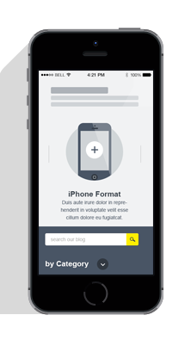


04
Click to add your text
Click to add your text
01 OPTION
02 OPTION
02 OPTION
Click to add your word click to add your word click to add your word click to add your word click to add
Click to add your word click to add your word click to add your word click to add your word click to add
Click to add your word click to add your word click to add your word click to add your word click to add

Slide 25

04
Click to add your text
Click to add your word
Click to add your word
30%
Click to add your word
Click to add your word
30%
Click to add your word
30%
Click to add your word
Click to add your word click to add your word click to add your word click to add your word click to add your word click to add your word click to add your word click to add
Click to add your word

Slide 26


04
Click to add your text
60%
60%
30%
35%
15%
Add your text
Click to add your word click to add your word
Add your text
Click to add your word click to add your word
Add your text
Click to add your word click to add your word
Add your text
Click to add your word click to add your word
10%
Add your text
Click to add your word click to add your word
Notes:
移动浮标到制定的位置表示

Slide 27
p.s.
模板内使用元素——中国地图

Slide 28

p.s.
模板内使用元素——icon

Slide 29







p.s.
模板内使用背景或文字填充图片

Slide 30
更多精品PPT资源尽在—优品PPT！
www.ypppt.com
PPT模板下载：www.ypppt.com/moban/ 节日PPT模板：www.ypppt.com/jieri/
PPT背景图片：www.ypppt.com/beijing/ PPT图表下载：www.ypppt.com/tubiao/
PPT素材下载： www.ypppt.com/sucai/ PPT教程下载：www.ypppt.com/jiaocheng/
Notes:
模板来自于 http://www.ypppt.com

